Slide 1
Assets Management with GPS
SEIS 742 Advanced Microprocessor
Alex Shtuk

Slide 2
Objectives
What is Asset Management with GPS?
How it works?
Block Diagram
Software Design
Demonstration

Slide 3
What is it?
Assets Management with GPS allows to track an asset’s position and generate a warning when distance from reference point to the asset is greater than allowed by user.
Can be used:
Pets
Equipment
Kids in daycare/playground

Slide 4
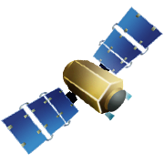
How it works?
Step 1. Find position at reference point

Slide 5
How it works?
Step 2. Find asset’s current position.
Step 3. Compute the distance between asset and reference point
Step 4. If the distance is greater than allowed then generate a WARNING.
Distance

Slide 6
Computing Distance using GPS data
Haversine Formula used in navigation (published by Roger Sinnott in Sky & Telescope magazine in 1984)
Part1 = sin²((lat2 – lat1)/2) + cos(lat1).cos(lat2).sin²((lon2 – lon1)/2)
Part2 = 2 * atan2 (√(Part1), √(1 – Part1))
Distance = Earth Radius (6371 km) * Part2,
where
Lat1 and lon1 at reference point
Lat2 and lot2 at current position of the asset

Slide 7
XBee Wireless Module
LS20031 GPS Receiver Module
UART1
UART2
NXP LPC1769 Cortex M3
BLOCK
DIAGRAM
BeagleBone ARM A8,
UART1
XBee Wireless Module
Internet
ETH0

Slide 8
Software Design NXP LPC1769 Cortex M3
Data from fix satellite received in NMEA Sentences:
$GPGGA – Global positioning system fixed data
$GPGLL – Geographic position latitude/longitude
$GPGSA – GNSS DOP and active satellites
$GPGSV – GNSS satellites in view
$GPRMC – Recommended minimum specific GNSS data
$GPVTG – Course over ground and ground speed
$GPGGA,053740.000,2503.6319,N,12136.0099,E,1,08,1.1,63.8,M,15.2,M,,0000*64

Slide 9
Software Design BeagleBone, Angstrom Linux OS

Slide 10
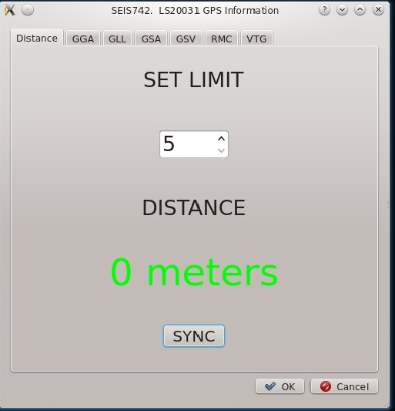
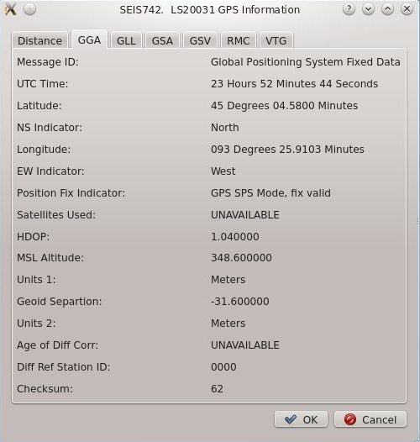
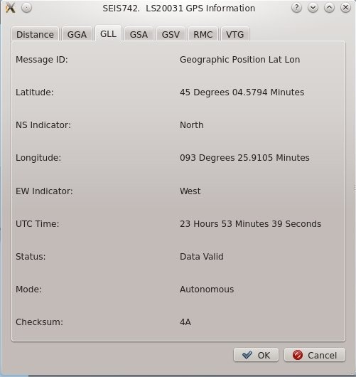
Software Design, Client

Slide 11
Demonstration

Slide 12
Questions?

